Slide 1
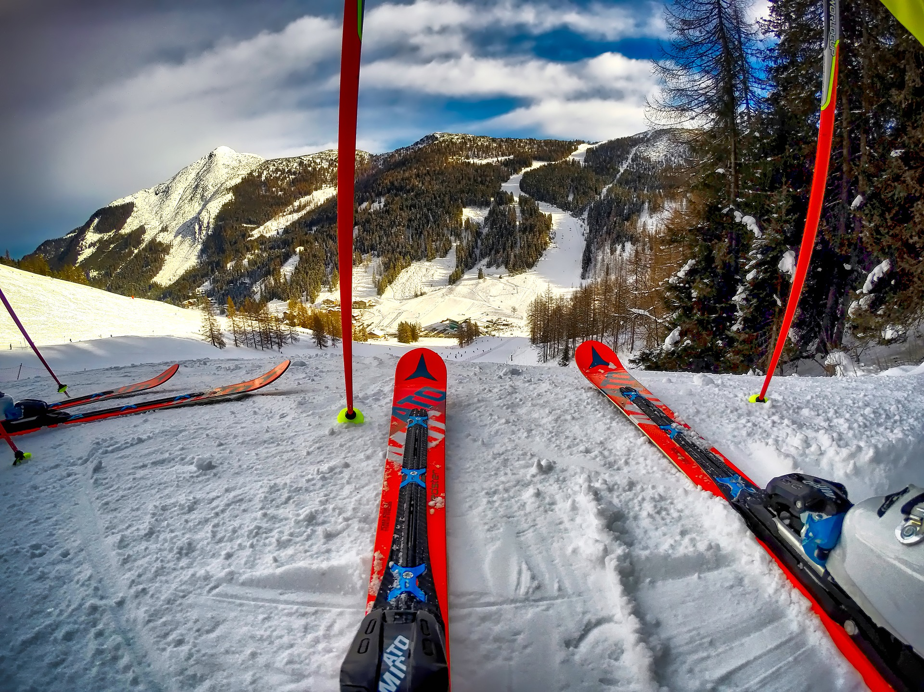
Big Mountain Resort
Strategies to Increase Revenue

Slide 2
The Problem
Big Mountain Resort is concerned that they are not capitalizing on their facilities and properly pricing their tickets
Big Mountain wants to use data to
Cut costs without undermining the value of their tickets, or
Make changes that will support a higher ticket price

Slide 3
The Goal
Increase revenue or cut costs for Big Mountain Resort by at least $1.6 million beginning next season by…
Identifying factors that drive ticket prices
Using these factors to increase Big Mountain’s ticket prices or reduce its operating costs

Slide 4
Recommendation and Key Findings
Increase ticket prices by at least $2.50
Consider the following options:
Closing at least one of the least-used runs
Adding a new run with a lower end point, thereby increasing vertical drop
The addition of another chair lift would be necessary to serve this run

Slide 5
Data Exploration
Feature Correlation Heat Map
Preliminary identification of the variables with the strongest correlation with ticket price
Highly correlated variables include: fastQuads, Runs, Snow Making_ac, resort_night_skiing_state_ratio, total_chairs, and vetical_drop

Slide 6
Modeling Results and Analysis
Random forest model selected as best model for ticket prices
Most important features: fastQuads, Runs, Snow Making_ac, vertical_drop
These variables match the variables identified in preliminary analysis

Slide 7
Modeling Closing Runs
Modeled the impact of closing the least-used runs on ticket prices
Closing one run has no impact on ticket price
Closing 3, 4, and 5 runs has the same impact
If Big Mountain decides to close 3 runs, they should close 5 runs

Slide 8
Modeling Adding Another Run
Modeled the impact of adding an additional run and installing a chair lift
This run would increase vertical drop by 150 feet
These additions would support a ticket price increase of $1.99
Yields an additional $3,474,638, which covers the $1,540,000 increase in chair lift operating costs
Adding more snow machines to cover the new run had no impact on the ticket price

Slide 9
Summary and Conclusion
Big Mountain does not currently charge as much for tickets as resort features enable
Revenue can be increased by:
Increasing ticket prices up to $94.22
Closing least-used runs
Adding a new run with a larger vertical drop

